Slide 1
Learning the k in k means
Presenter: Johnny Lee, Frank Zhao

Slide 2
Quick refresher on k means
A popular approach to clustering
Divides n data samples into k number of partitions iteratively according to some measurement threshold.
We need to specify a k
Notes:
How does K means work?

Slide 3
Problem: how to determine k?
A hard problem
Often no obvious answer
Even harder when many dimensions are involved
Generally an ad hoc decision based on prior knowledge / assumptions about the data
Relies on heuristics and ”human intuition”
Can we automatically estimate the k value?

Slide 4
Previous approach
X means
Searches many k values, the rank the score using Bayesian Information Criterion (BIC)
Minimum description length method
Deductive: uses large values for k and reduce k if the choice reduces description length
Other hierachical, dendrogram based methods
Requires domain-specific knowledge and human intuition

Slide 5
G means
This paper’s contribution
A method to automatically estimate the k value.
Key idea:
Hypothesis: a subset of data should follow a Gaussian distribution
Runs k-means with increasing k in hierarchical fashion until subset meets hypothesis
At each step, run a statistical test to see if the subset is Gaussian
Notes:
--What if it doesn’t follow Gaussian distribution (Can we run experiments?)

Slide 6
How does it work?
The algorithm:
start with a small number of k-means centres, and increase them
Each iteration split a centre into 2 if the data does not appear to fit a Gaussian distribution
Run k means on global dataset between each iteration
How do we know whether the data is Gaussian?
Use a statistical test to verify–in this case, Anderson-Darling statistic

Slide 7
A step by step example

Slide 11
Benefits of G means
Only requires one intuitive parameter
alpha rate, which is the confidence level of the statistical test
Efficiency:
Low computation cost, does not compute full covariance matrix

Slide 12
Experimentations :X-means vs G-means
Round 1 : Clustering spherical data
Both X-means and G-means perform equally well
But real world data is often not spherical (!)

Slide 13
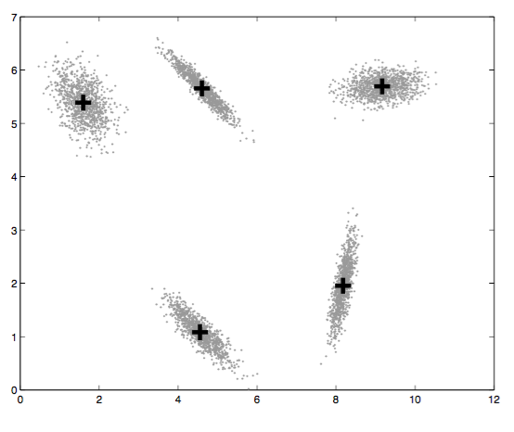
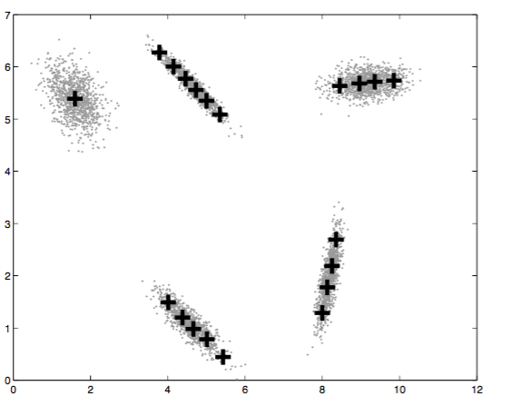
Round 2: Non-spherical dataset
G means performs better in non-spherical data
X-means tend to over fit the data

Slide 14
Round 3: dealing with high dimensions
Efficiency / scalability:
X means is faster than G-means in low dimensions, but has poor scalability
When d > 8, X means becomes very slow
G means speed does not increase significantly with dimensions
Accuracy
Tested on NIST, and handwriting dataset
G means found 31 clusters in 30 seconds
X means found 715 clusters in 4149 seconds, 369 contained only 1 point

Slide 15
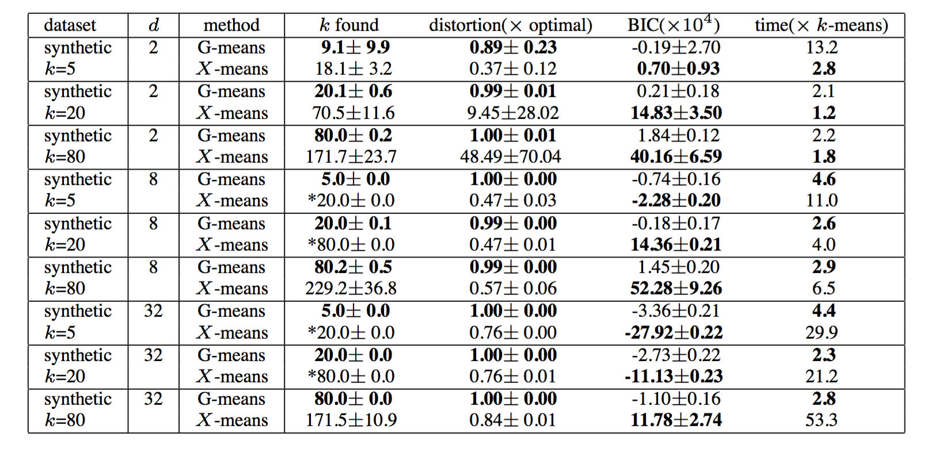

Slide 16
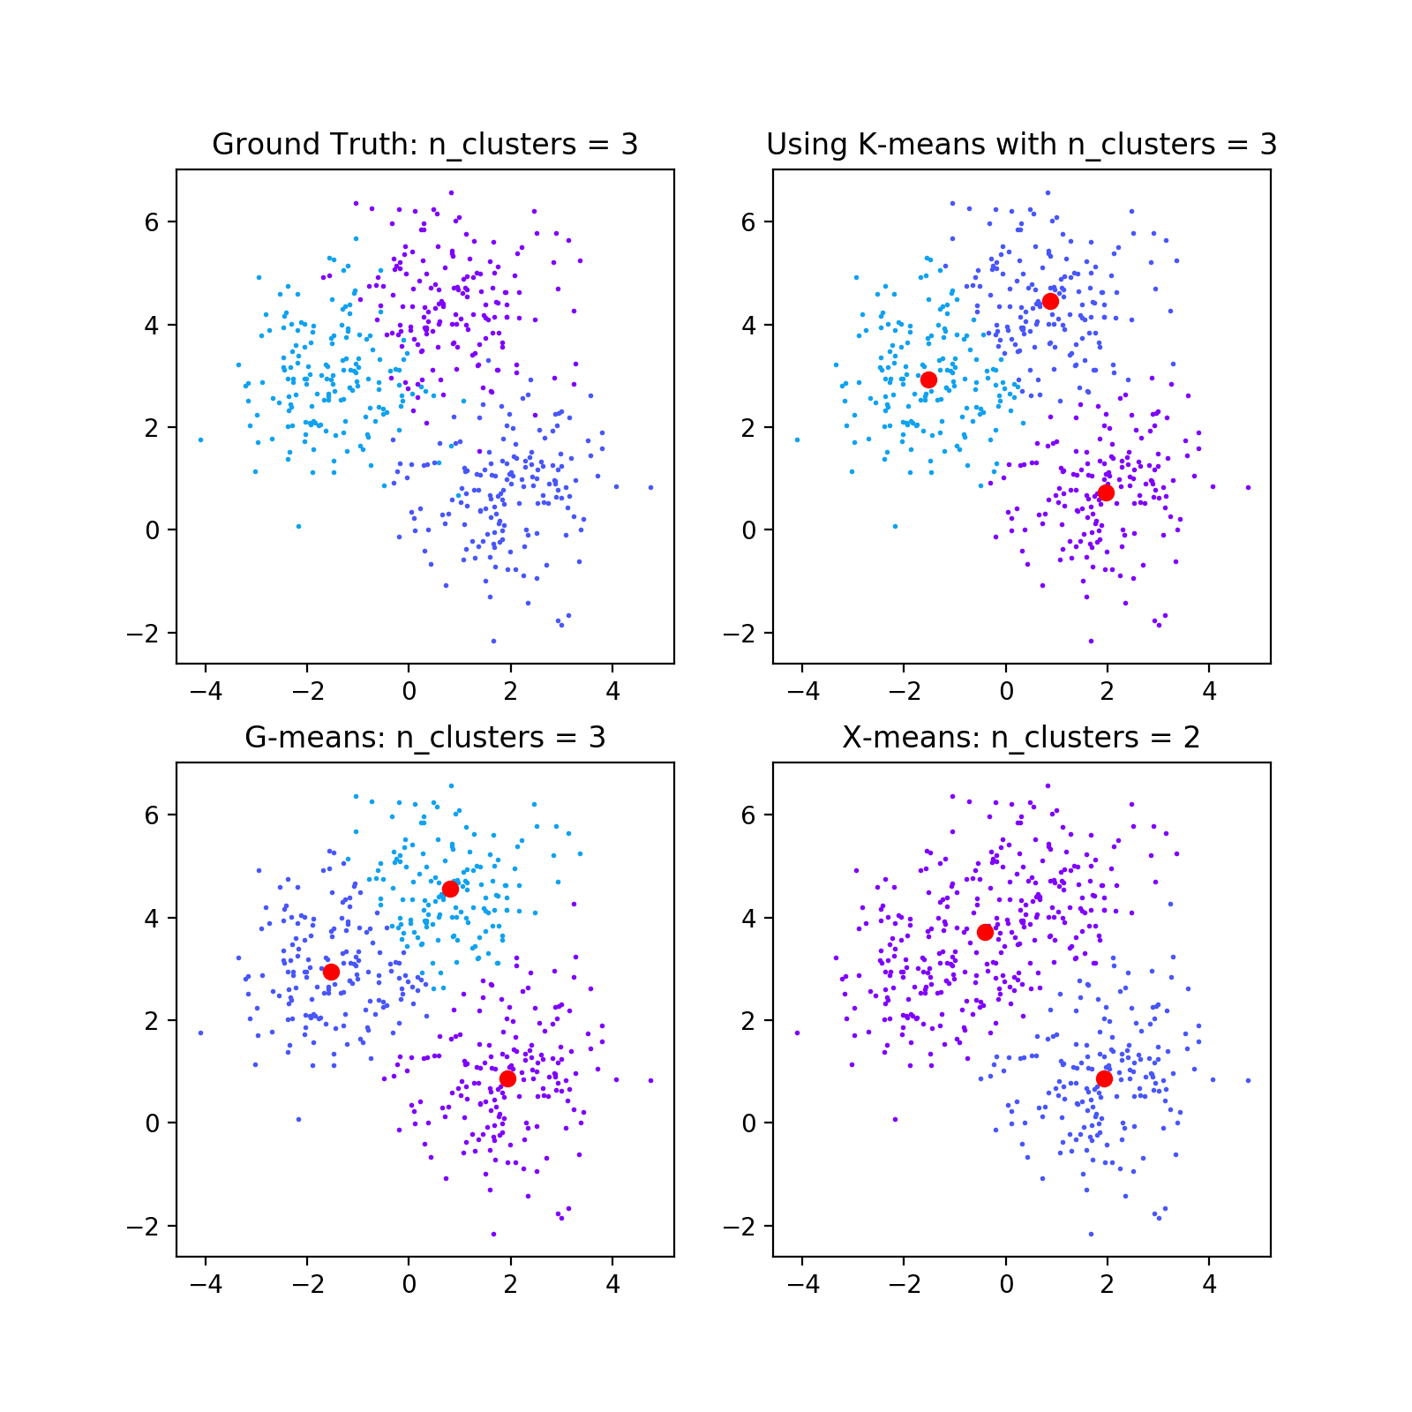
G-Means is good
samples = 500
features = 2

Slide 17
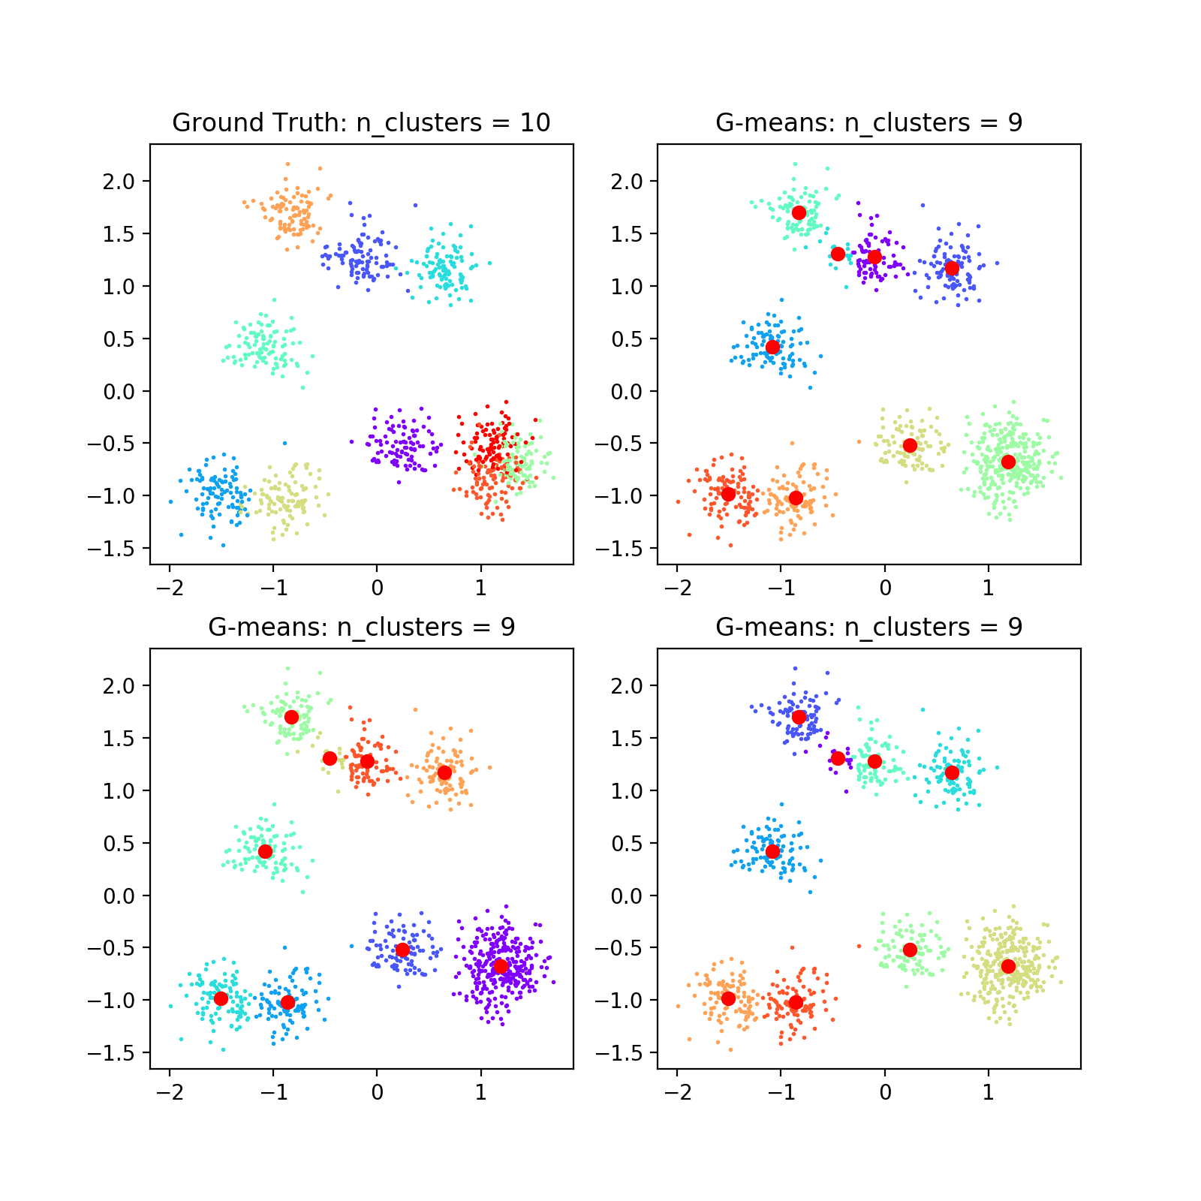
G-means is good
samples = 1000
features = 2
random state = 100

Slide 18
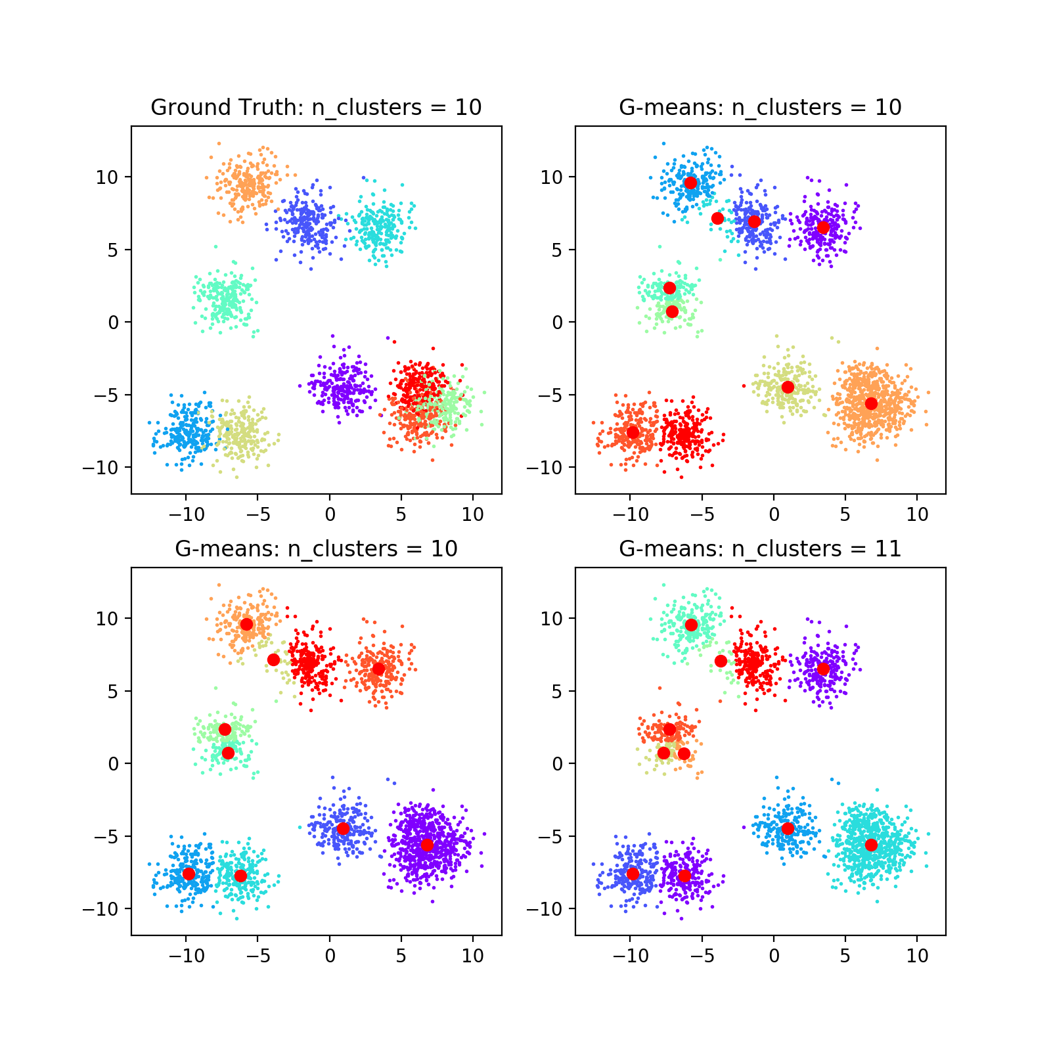
G-means is good
samples = 2300
features = 2

Slide 19
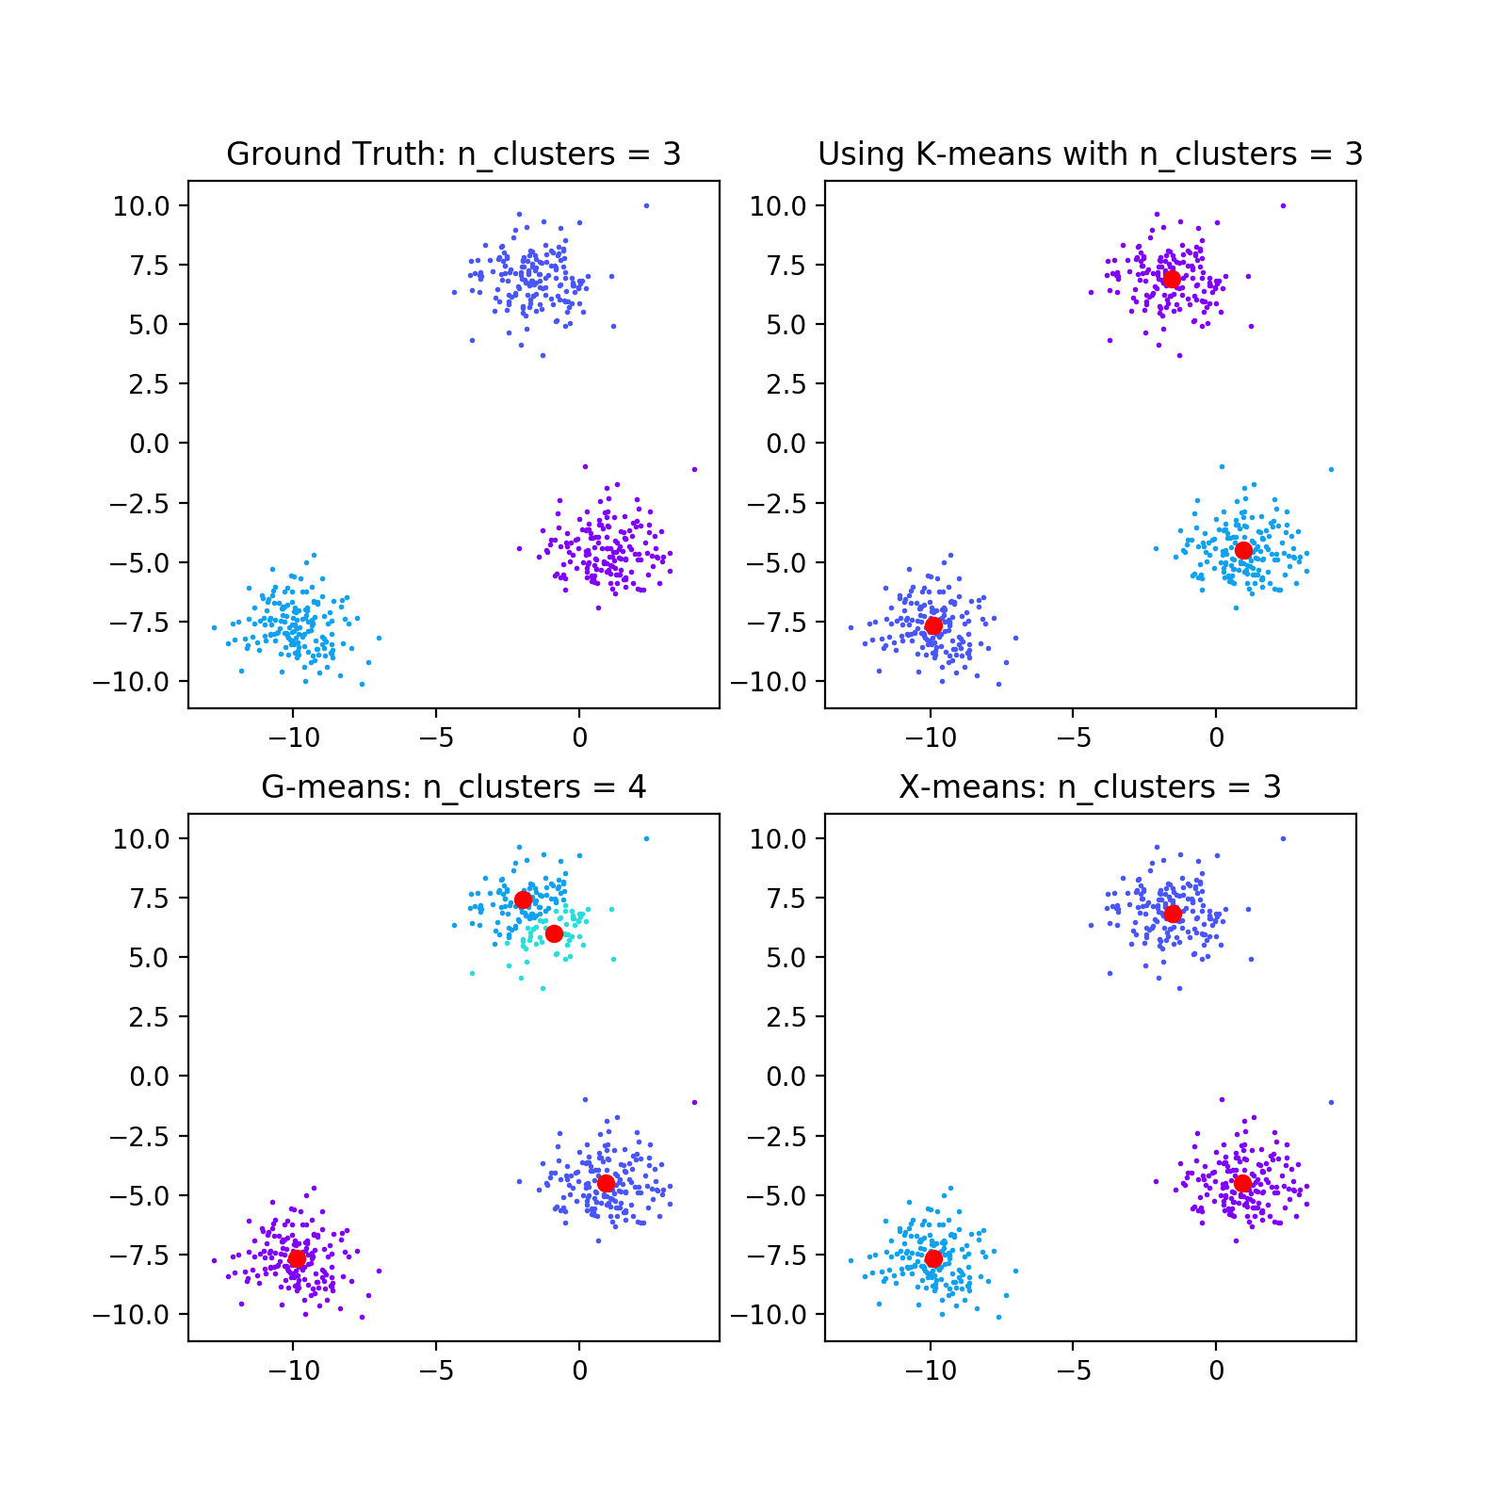
G-means is not stable
samples = 500
features = 2
random state = 100

Slide 20
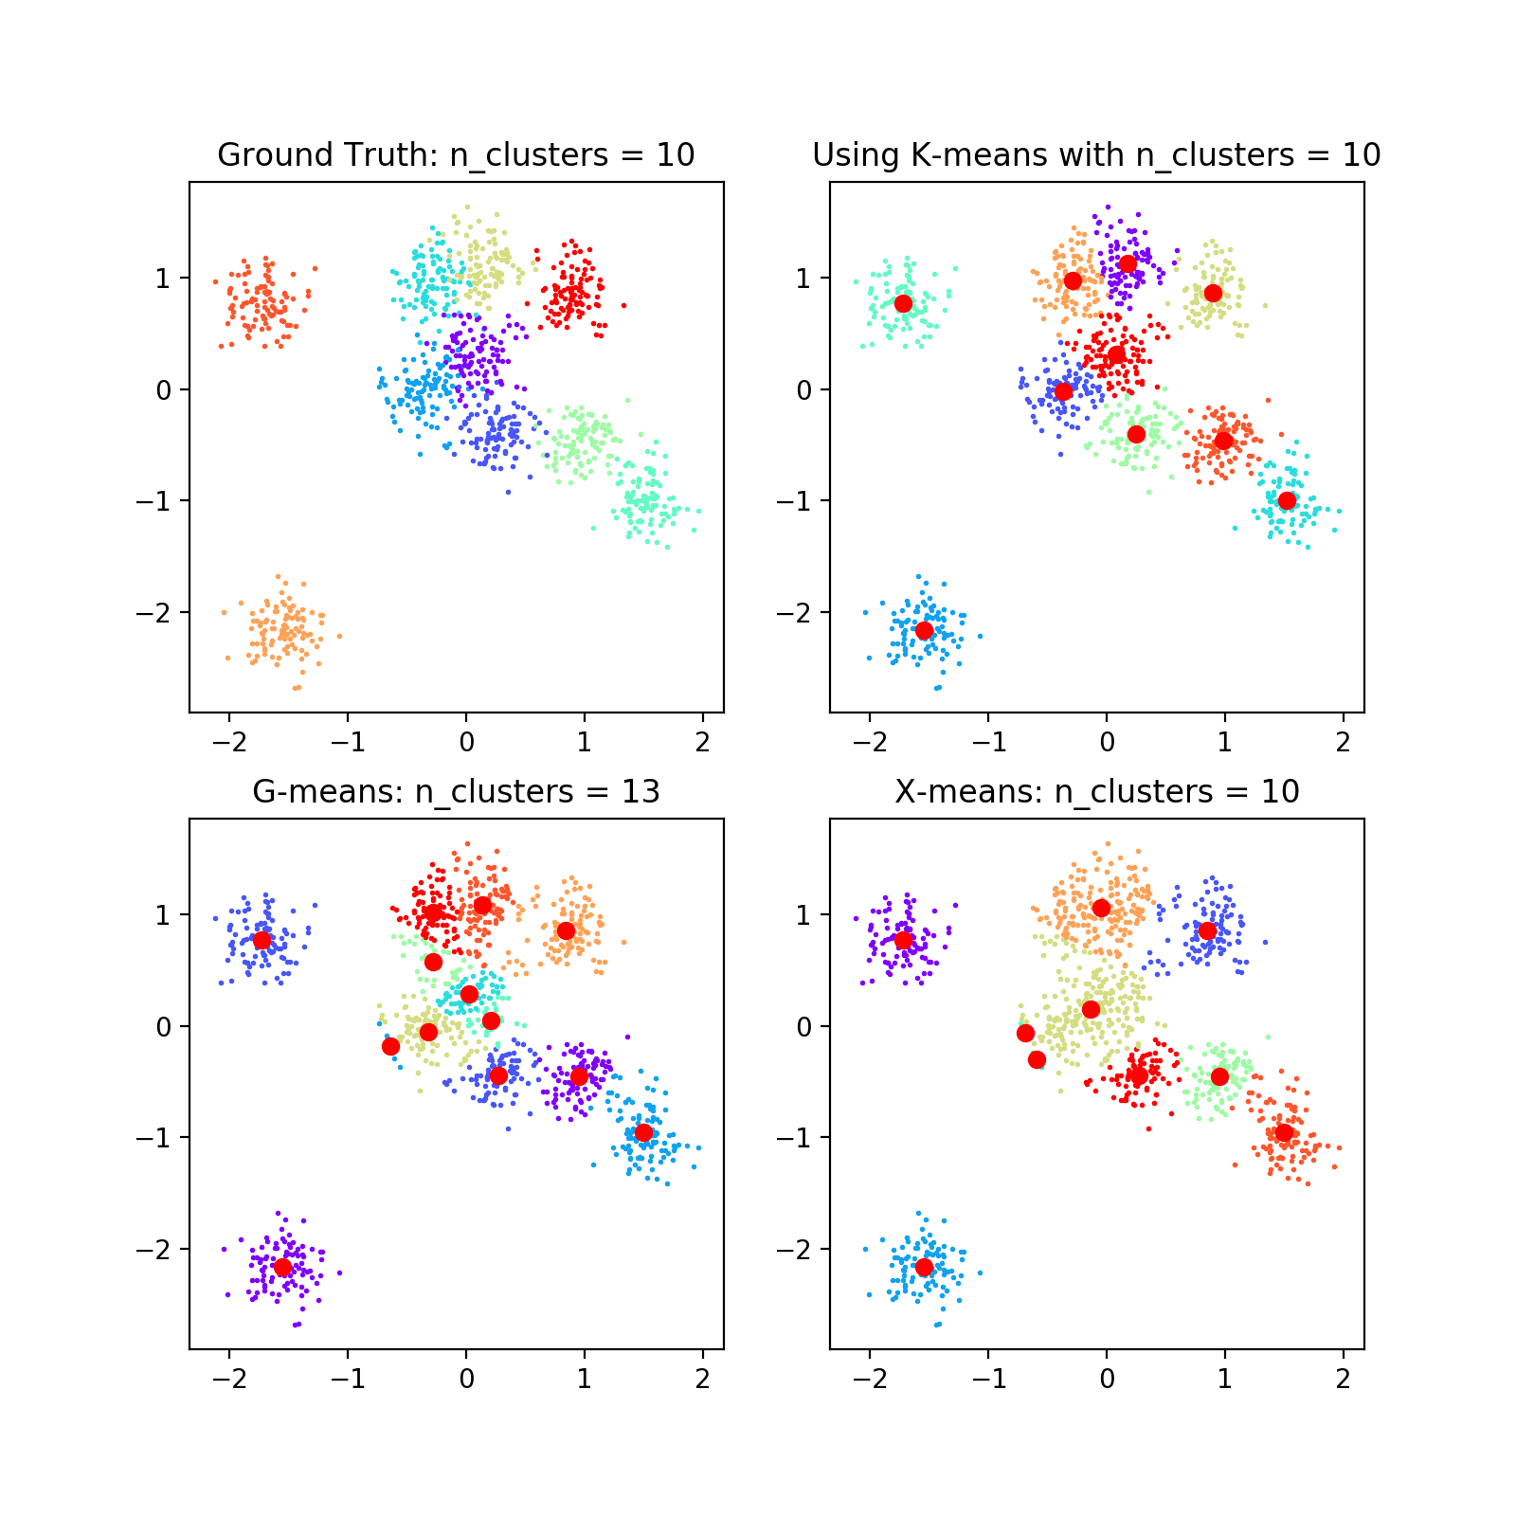
K-means, G-means and X-means
samples = 1000
features = 2
random state = 0

Slide 21
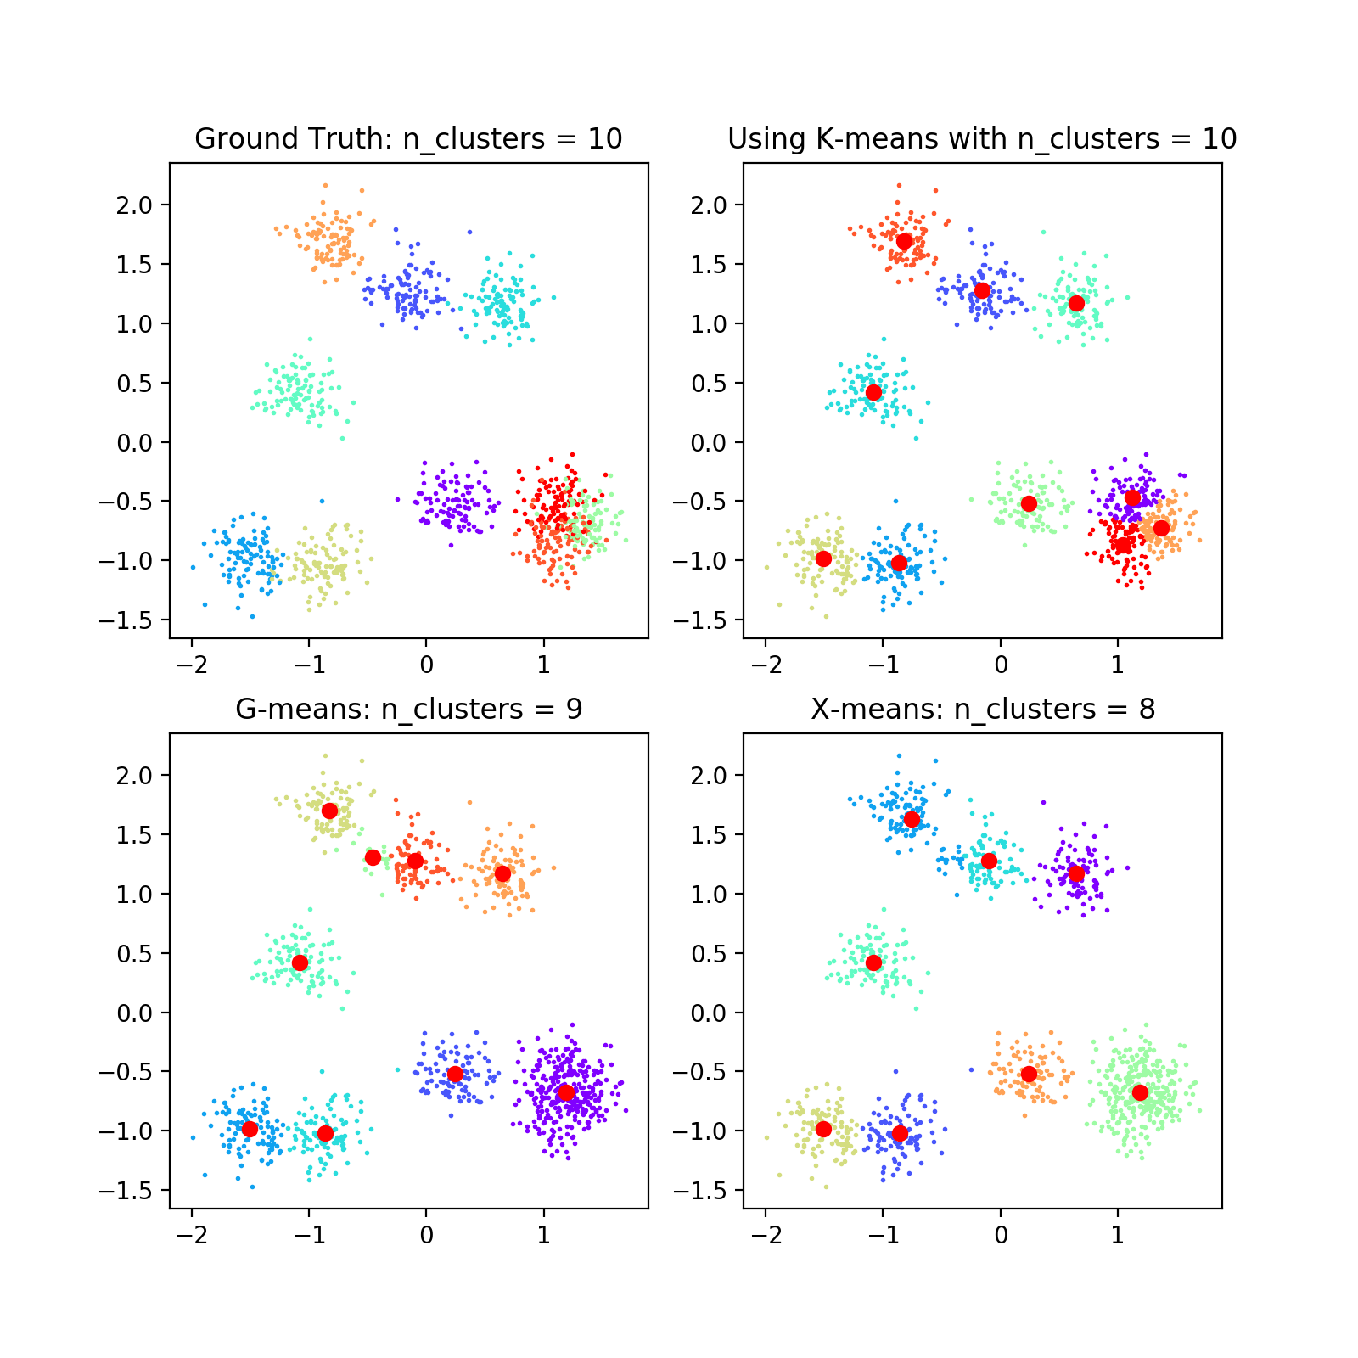
K-means, G-means and X-means
samples = 1000
features = 2
random state = 100

Slide 22
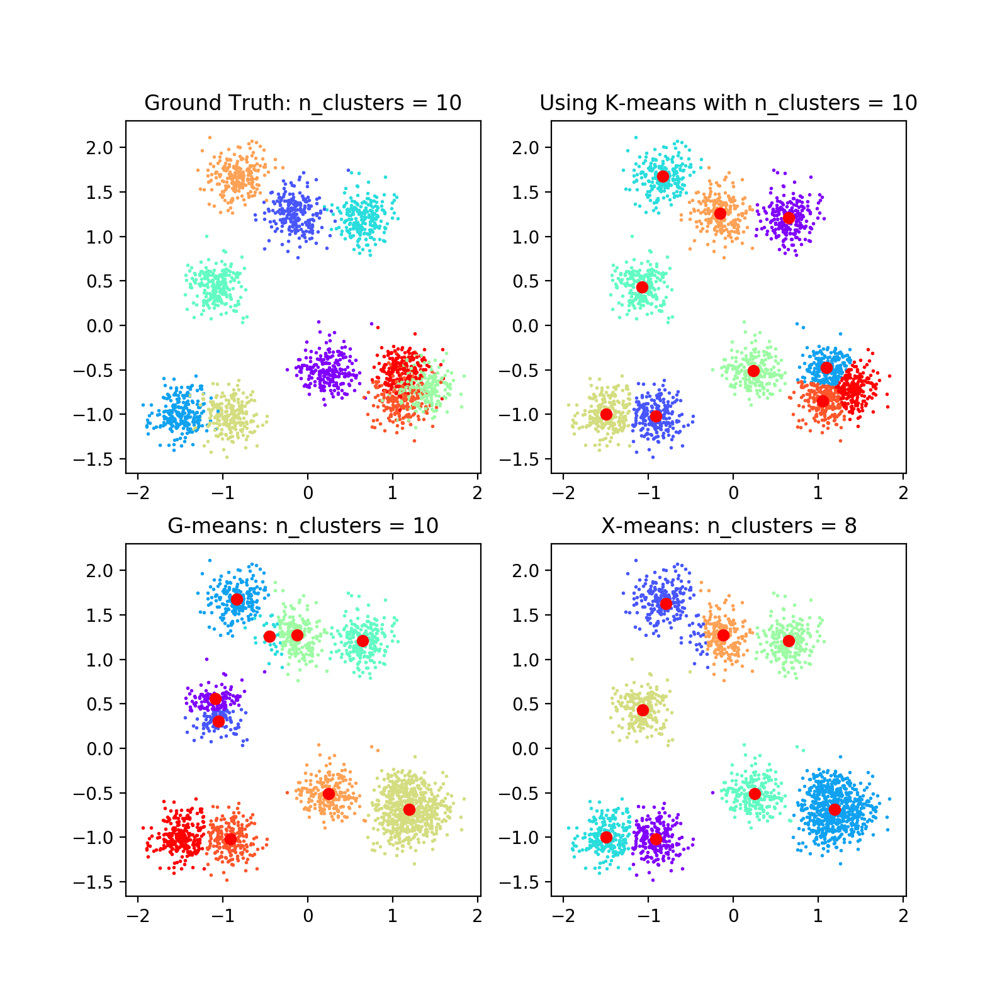
K-means, G-means and X-means
samples = 2300
features = 2
random state = 100

Slide 23
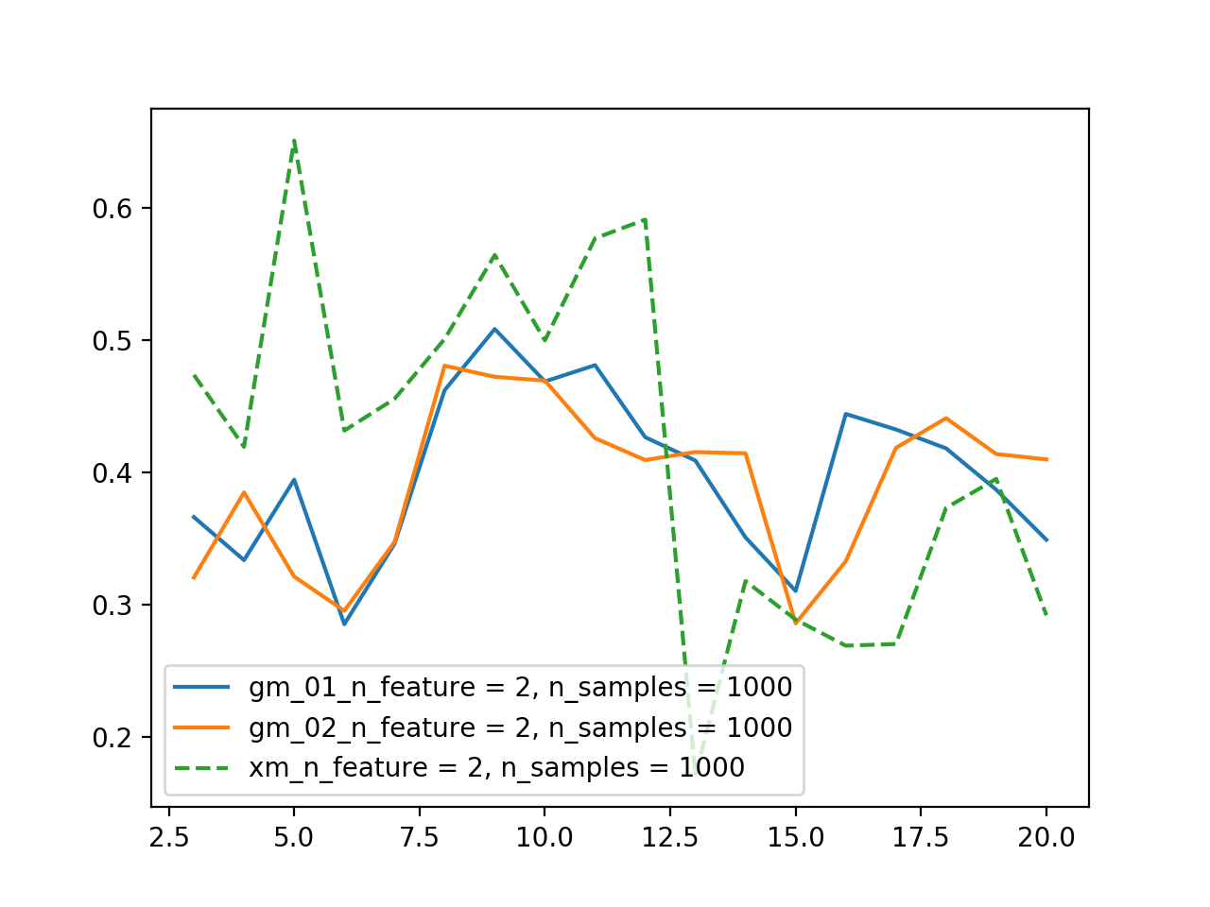
statistical summary
samples = 1000
features = 2
random state = 0

Slide 24
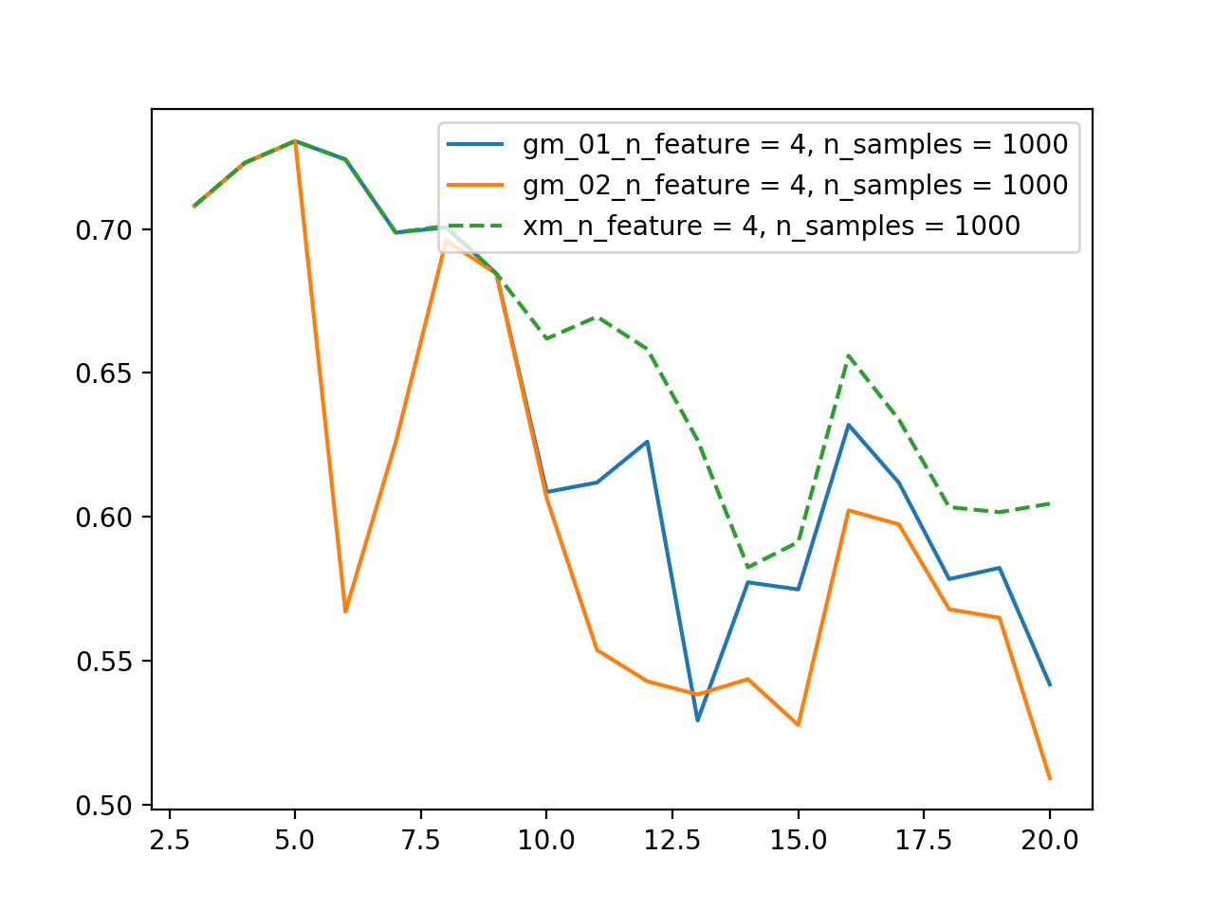
statistical summary
samples = 1000
features = 4
random state = 0

Slide 25
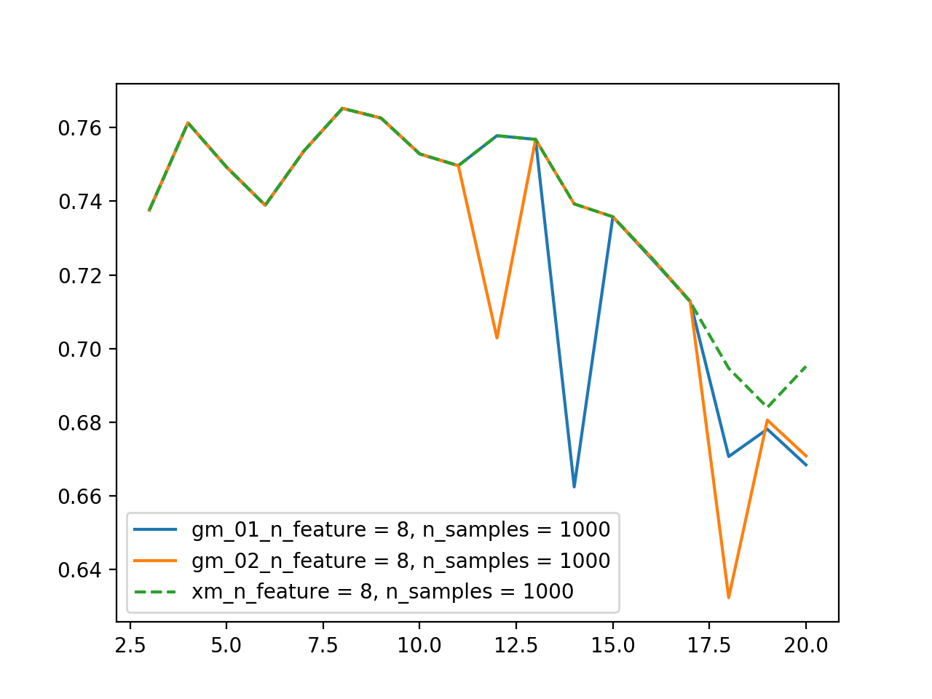
statistical summary
samples = 1000
features = 8
random state = 0

Slide 26
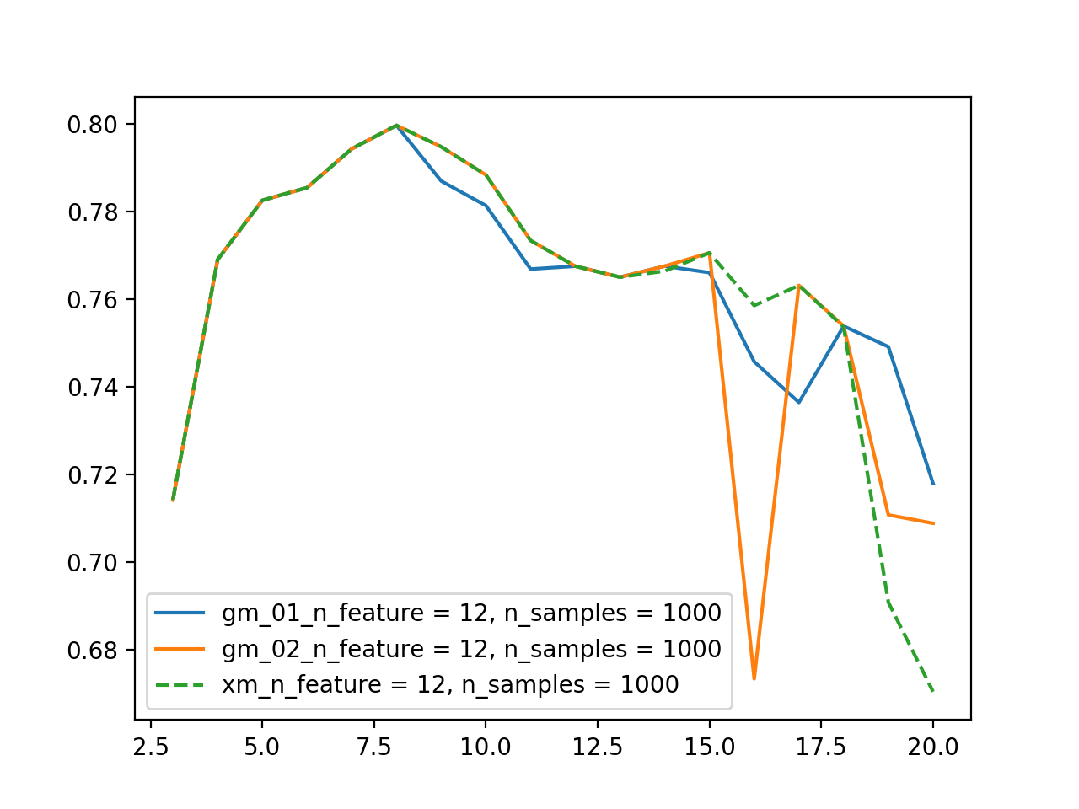
statistical summary
samples = 1000
features = 12
random state = 0

Slide 27
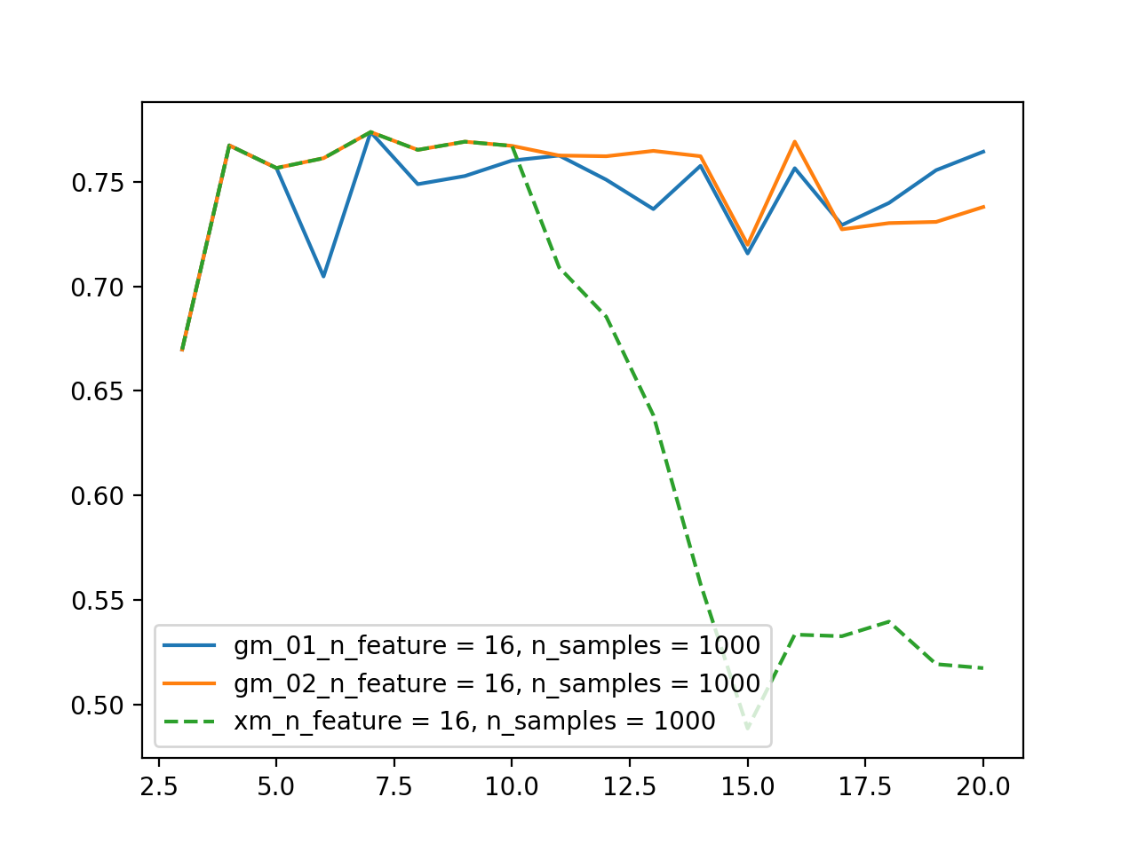
statistical summary
samples = 1000
features = 16
random state = 0

Slide 28
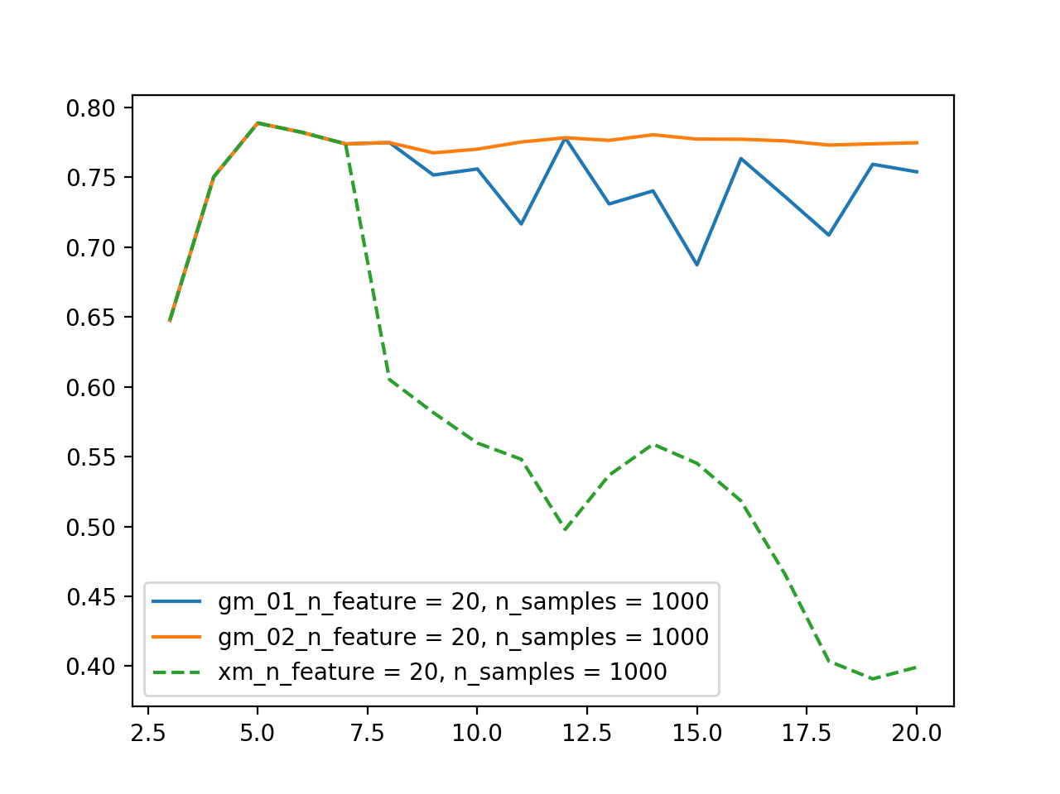
statistical summary
samples = 1000
features = 20
random state = 0

Slide 29
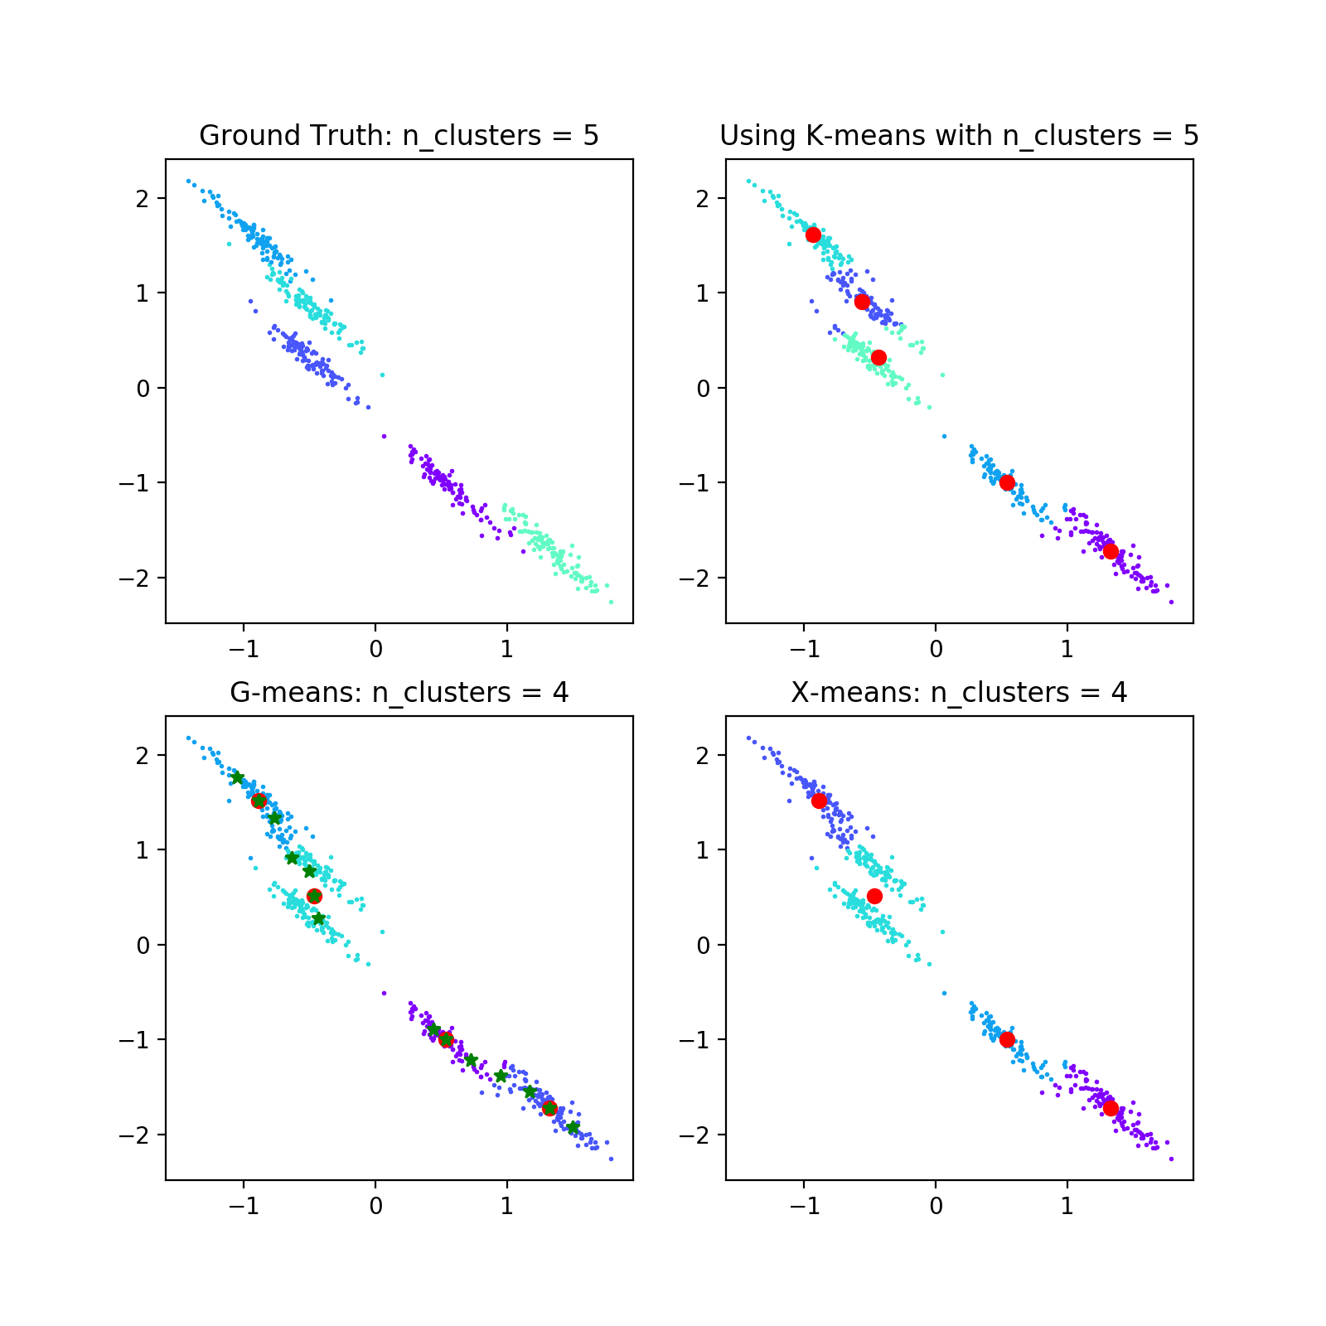
limitation of G-means

Slide 30
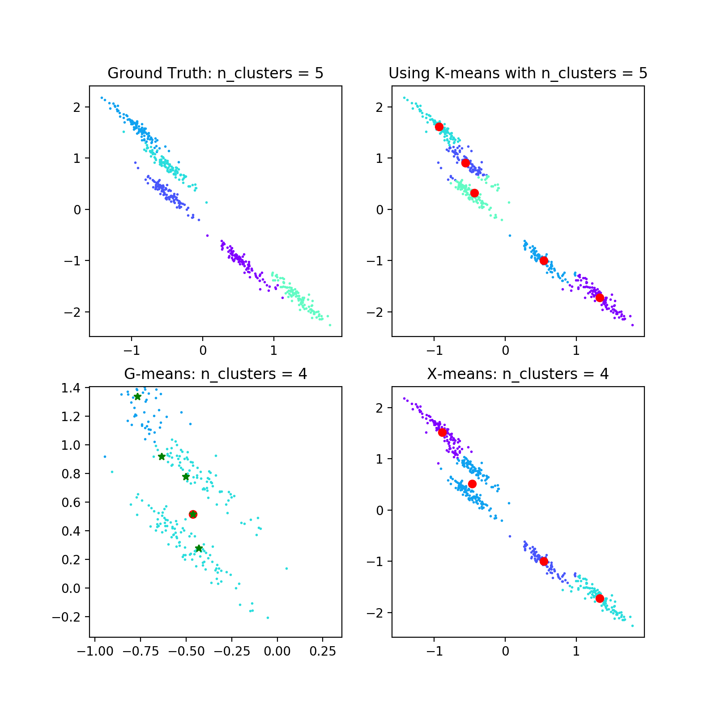
limitation of G-means

Slide 31
Summary
G-means can automatically choose the right k value
G-means are not as good as expected
G-means is not as accurate as X-means
G-means is not stable
G-means is limited by k-means

Slide 32
References
https://blog.bigml.com/2015/02/24/divining-the-k-in-k-means-clustering/

